Slide 1



Predicting Salaries for Data Professionals

Slide 2
Problem Statement:
The data profession landscape is plagued by salary uncertainty, with wages varying wildly based on experience, job role, and performance. This lack of transparency creates a power imbalance, leaving job seekers in the dark about their worth. Accurately predicting salaries is crucial for bridging this gap, enabling fair compensation and competitive offers. A reliable salary prediction model can bring clarity to the market, empowering data professionals to make informed career decisions.

Slide 3
Dataset Description:
The dataset contains the following columns:
FIRST & Last NAME: Name of the Employee
SEX: Gender
DOJ: Date of joining the company
CURRENT DATE: Current date of data
DESIGNATION: Job role/designation
AGE: Age
SALARY: Target variable, the salary of the data professional
UNIT: Business unit or department
LEAVES USED: Number of leaves used
LEAVES REMAINING: Number of leaves remaining
RATINGS: Ratings or performance ratings
PAST EXP: Past work experience

Slide 4

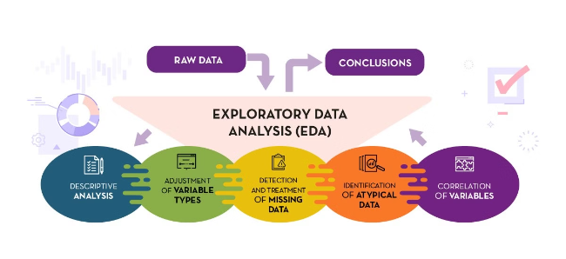
Exploratory Data Analysis (EDA)
1
Data Visualization
EDA uses charts and graphs to reveal patterns and trends in the data, allowing for easier identification of potential relationships and outliers.
2
Summary Statistics
Quantitative measures such as mean, median, standard deviation, and percentiles provide a numerical summary of the data's distribution and central tendency.
3
Pattern Identification
EDA aims to uncover relationships between variables, identify potential anomalies, and gain insights into the structure and characteristics of the data.

Slide 5

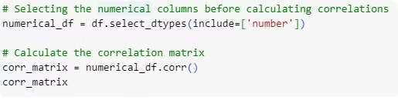
Correlation Matrix:
A correlation matrix is a table showing the correlation coefficients between multiple variables in a dataset. Each cell in the table represents the correlation between two variables.

Slide 6
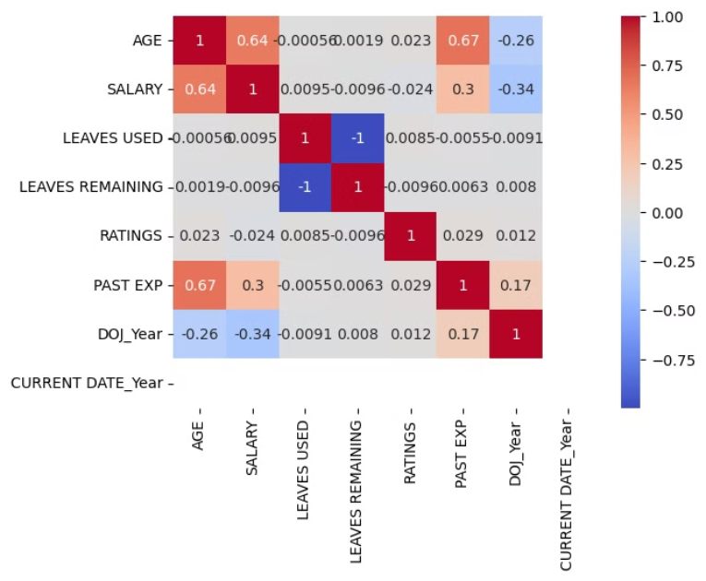
Heatmap
A heatmap is a data visualization tool that uses color gradients to represent the magnitude of values in a matrix format.
It is particularly useful for displaying the correlation matrix, which shows the relationships between different numerical variables.

Slide 7
Feature Engineering
Experience
Job Role
Performance
Years of experience in the field, specific skill sets, and relevant industry knowledge are crucial factors for salary determination.
Specific job roles within the data profession, such as data scientist, data analyst, or data engineer, come with varying levels of responsibility and compensation.
Quantifiable performance metrics, such as project success rates, contributions to company goals, and impactful achievements, significantly influence salary potential.

Slide 8

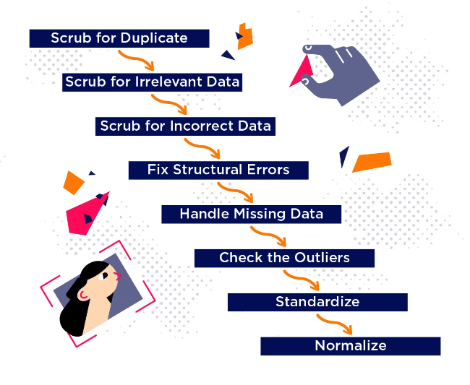
Data Preprocessing
1
Handling Missing Values
Addressing missing data points is essential. Techniques include imputation, deletion, or using specialized algorithms designed to handle missing data.
2
Encoding Categorical Variables
Transforming categorical features, such as job titles or locations, into numerical representations suitable for machine learning models.
3
Scaling/Normalization
Scaling or normalizing numerical features ensures that all variables are on a comparable scale, improving the performance of certain algorithms.

Slide 9
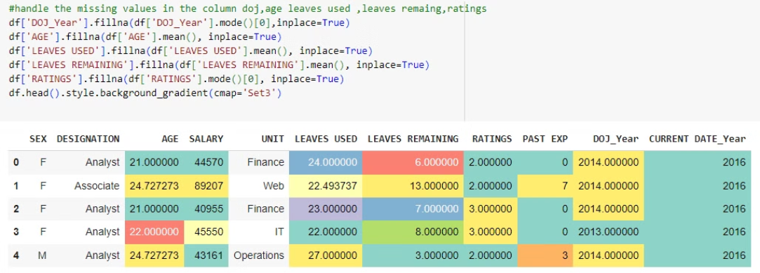
Data Cleaning-Handling the Missing value:

Slide 10
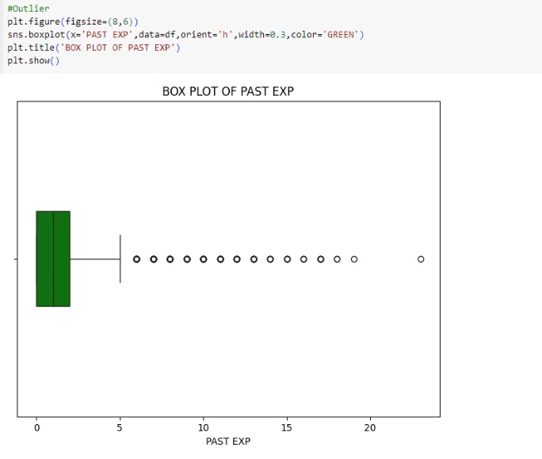
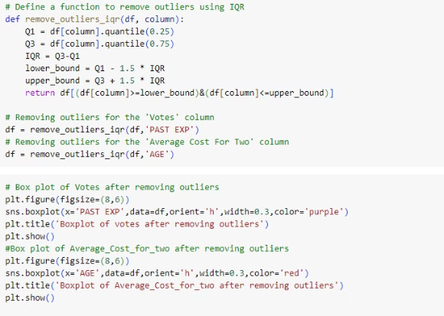
Data Cleaning-Handling the Outlier

Slide 11
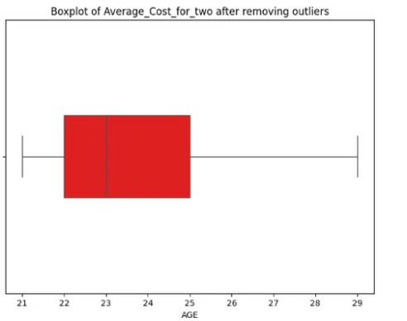
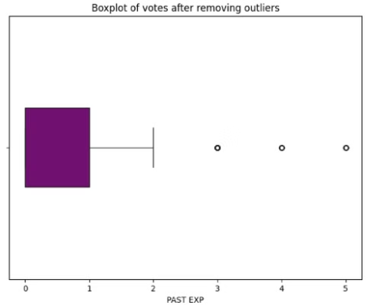
Data Cleaning - Outliers and Missing Values Removal
Now that we've handled the missing values and removed any outliers, it's time to take a closer look at the data. This step is crucial in preparing the dataset for machine learning model development. This step will help us gain a deeper understanding of the data and identify any potential issues or biases that may affect the performance of our machine learning models. By thoroughly reviewing the data at this stage, we can make informed decisions and set the stage for successful model development.

Slide 12

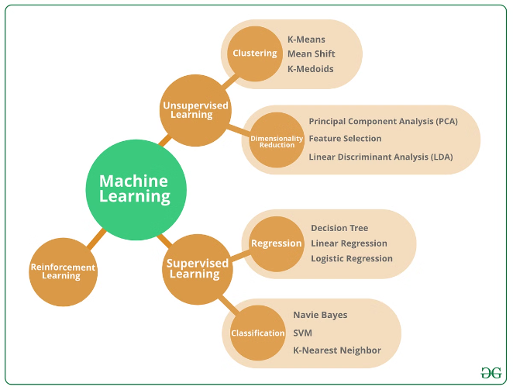
Machine Learning Model Development
Linear Regression
A simple yet powerful model that establishes a linear relationship between independent variables and the target variable (salary).
Decision Trees
A tree-based model that partitions the data into subsets based on specific features, leading to a decision on the predicted salary.
Random Forests
An ensemble method that combines multiple decision trees to improve accuracy and reduce the risk of overfitting.
Gradient Boosting
A powerful technique that sequentially builds multiple weak models, iteratively improving the prediction by focusing on areas where the previous model made errors.

Slide 13
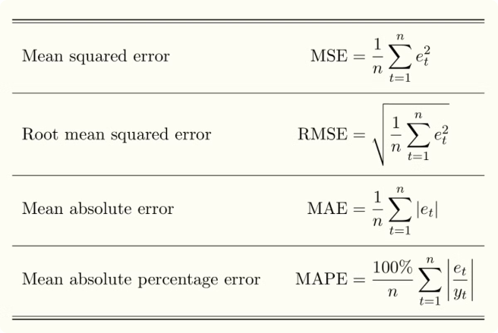
Model Evaluation
Metric
Description
Mean Absolute Error (MAE)
Average absolute difference between predicted and actual salaries.
Mean Squared Error (MSE)
Average squared difference between predicted and actual salaries, penalizing larger errors.
Root Mean Squared Error (RMSE)
Square root of MSE, providing an error measure in the same units as the target variable (salary).
R-squared (R2) Score
A measure of how well the model fits the data, ranging from 0 to 1, with 1 indicating a perfect fit.

Slide 14
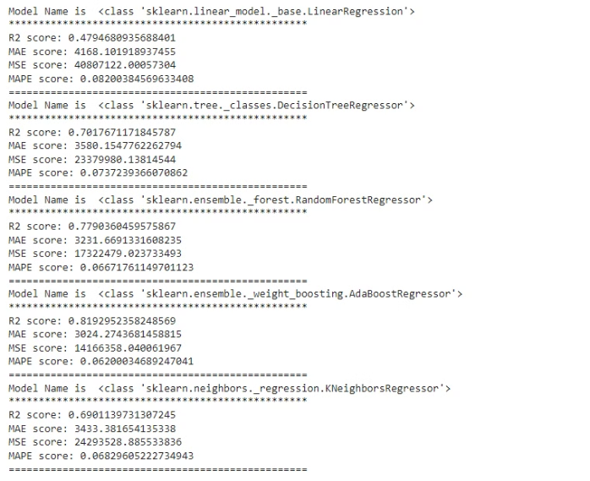
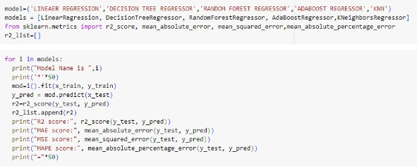
Model Evaluation

Slide 15


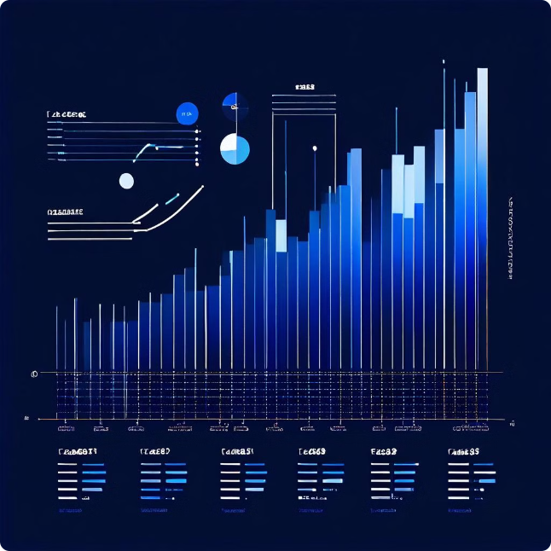


Choosing the Best Model
Evaluation
Evaluate the performance of different models using various metrics, such as MAE, MSE, RMSE, and R-squared.
Comparison
Compare the performance of different models based on their evaluation metrics, considering factors like bias, variance, and model complexity.
Selection
Choose the model that performs best on the given dataset and best meets the specific requirements of the prediction task.

Slide 16
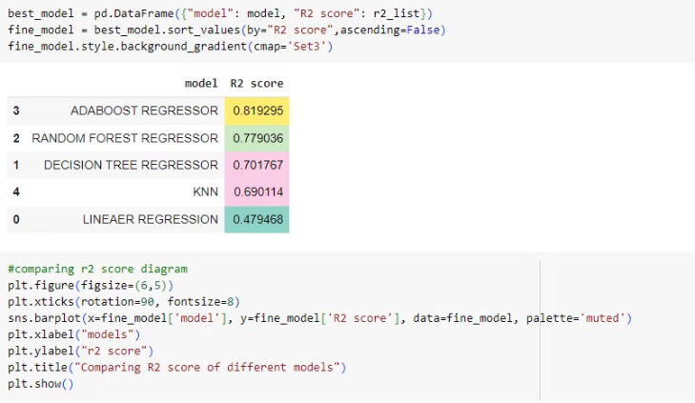
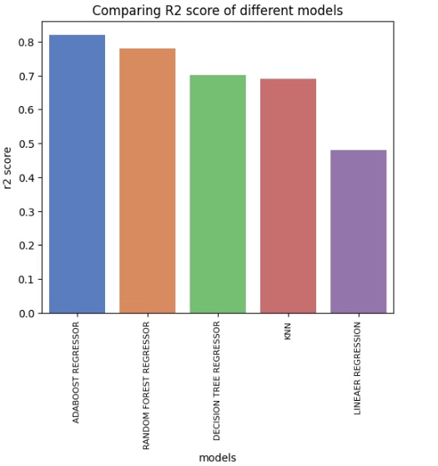
Choosing the Best Model

Slide 17
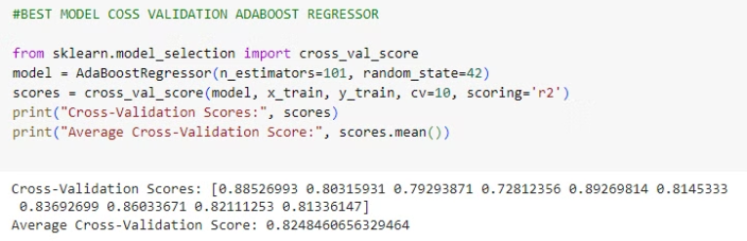
Conclusion :
We have meticulously analyzed the dataset, identifying key trends and patterns that influence the salaries of data professionals. Through rigorous development and evaluation of various machine learning models, we have selected the most accurate and reliable model for predicting salaries. This best-fit solution ensures precise salary predictions, providing valuable insights and benefits for both job seekers and employers in the data profession industry.

